Slide 1
Data visualization and dashboards with tableau
Project – Jacob Elumeze

Slide 2
Objective
Project Flow Structure
1. Connecting to APIs & Import Data
3. Review Objectives
4. Data manipulations and calculated fields
6. Create meaningful viz. & data insights
5. Building a Model & QA
2. Exploratory Analysis & Assumptions
The objective of this project was to create dashboards using various visualizations and insights from data on Real Estate Prices and Incomes across various districts within Canada
With the insights generated, stakeholders and end users can better understand the changes in real estate prices over the years across various districts in Canada and also see how that compares with changes in earnings over the years as a driver for home purchasing patterns across places of interest in Canada.

Slide 3
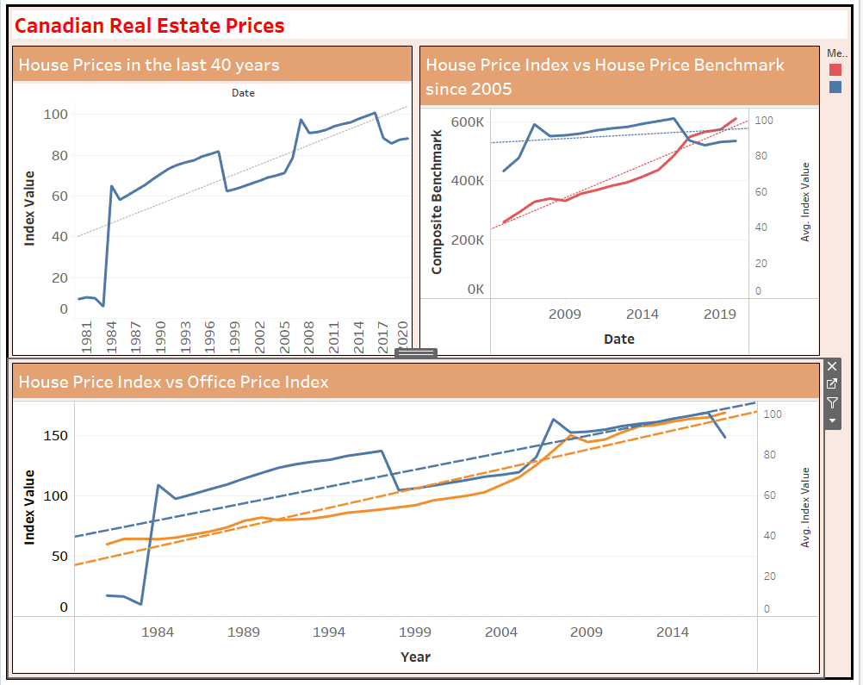
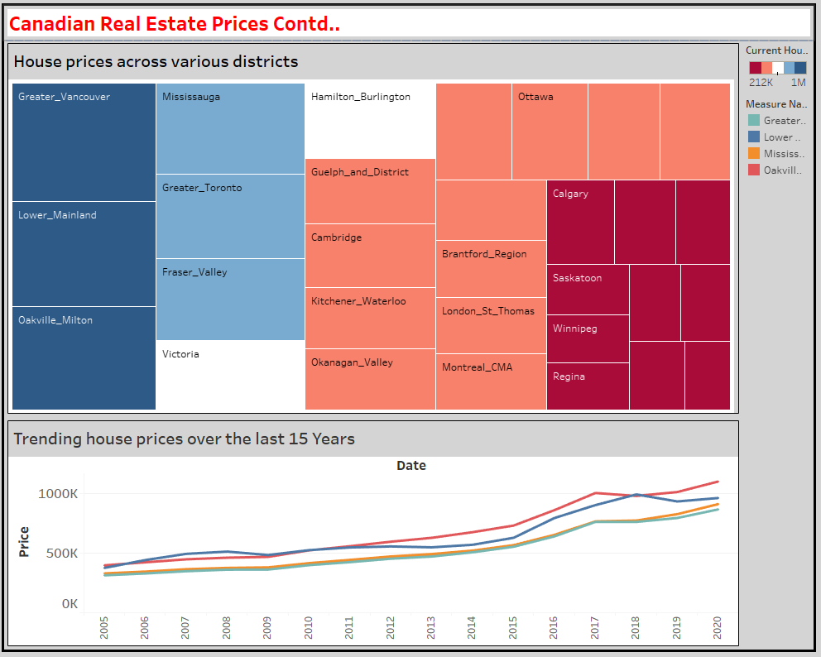
Results and findings

Slide 4
Results AND FINDINGS
The price of homes (and offices) has consistently increased in the last 40 years, with the highest jump happening between 1983 and 1984
01
01
Earnings across Canada has also grown at a consistent rate year on year.
Real Estate Price Trends
Earnings Trends
The Canadian districts with the most expensive homes are Greater Vancouver, Lower Mainland and Oakville Milton.
Across these districts, the difference in the price of homes has also stayed relatively the same.
02
02
In 2001, Canadians spent over 150% of their incomes on home expenses. But in 2014, the value dropped significantly to slightly over 50%.
Districts: Insights
Spending Insights
03
03
03
I cannot see any direct correlation between the key economic events in the past and incomes or real estate prices in Canada.
There isn't any difference between the Consumer Price Index and House Price Index over the years.
Both grew at the same rate
Contributing Factors
Business Information
There is a slight relationship with the prices of house constructions, with the cost of construction materials experiencing a dip in those key years
Key Economic Indicators
Trend Analysis on datapoints from Canadian Open Data portal

Slide 5
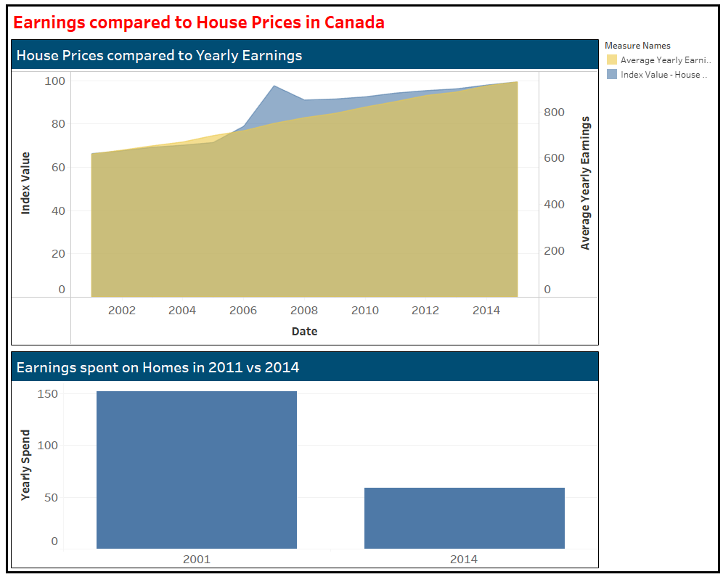
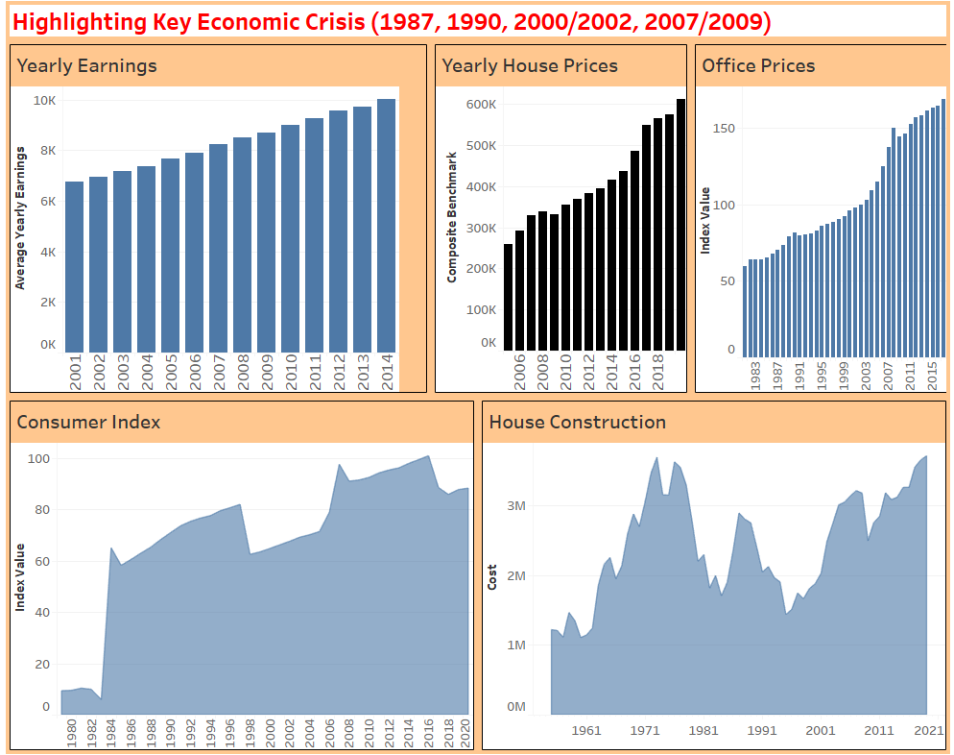
Results and findings

Slide 6
Challenges, learning points & QA PROCESS
Had some challenge with importing the JSON file into tableau, as such, the resulting table was not accurate. I resolved this by importing the file into python and using pandas to convert it into a data frame, then exported it to CSV.
Struggled with data modelling and manipulating data in Tableau, but I believe this will improve as I practice more with the application.
Lastly, I am not sure if it is due to the version of the application I have but I had some limitations with selecting certain visualizations that I needed
Need to improve more in being able to easily understand the underlying objective to easily identify data relationships.

Slide 7
Thank You

